Slide 1
Password Protector
Andrew Guilbeau
Christopher Sickler
Lei Liu
Christopher Gang

Slide 2
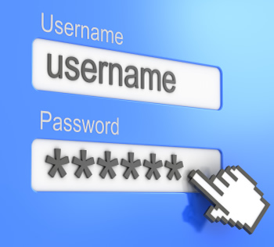
Motivation
Reduce password redundancy
Reduce password theft
Increase password diversity with minimal effort
Generate account passwords

Slide 3

Key features
Log-in requires a key every time
Password generation is secure
Create, delete and edit accounts
Passwords accommodate user requirements
Passwords have security answers
No internet access required

Slide 4
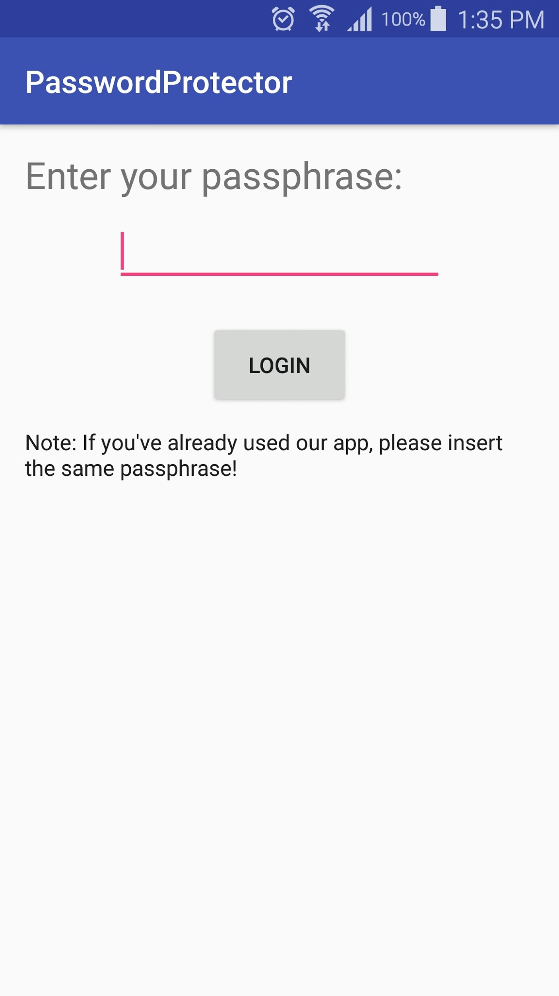
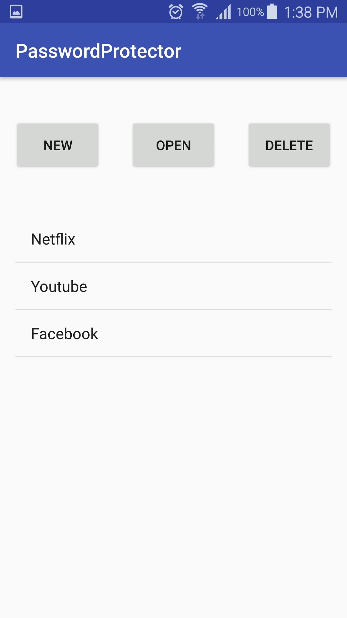
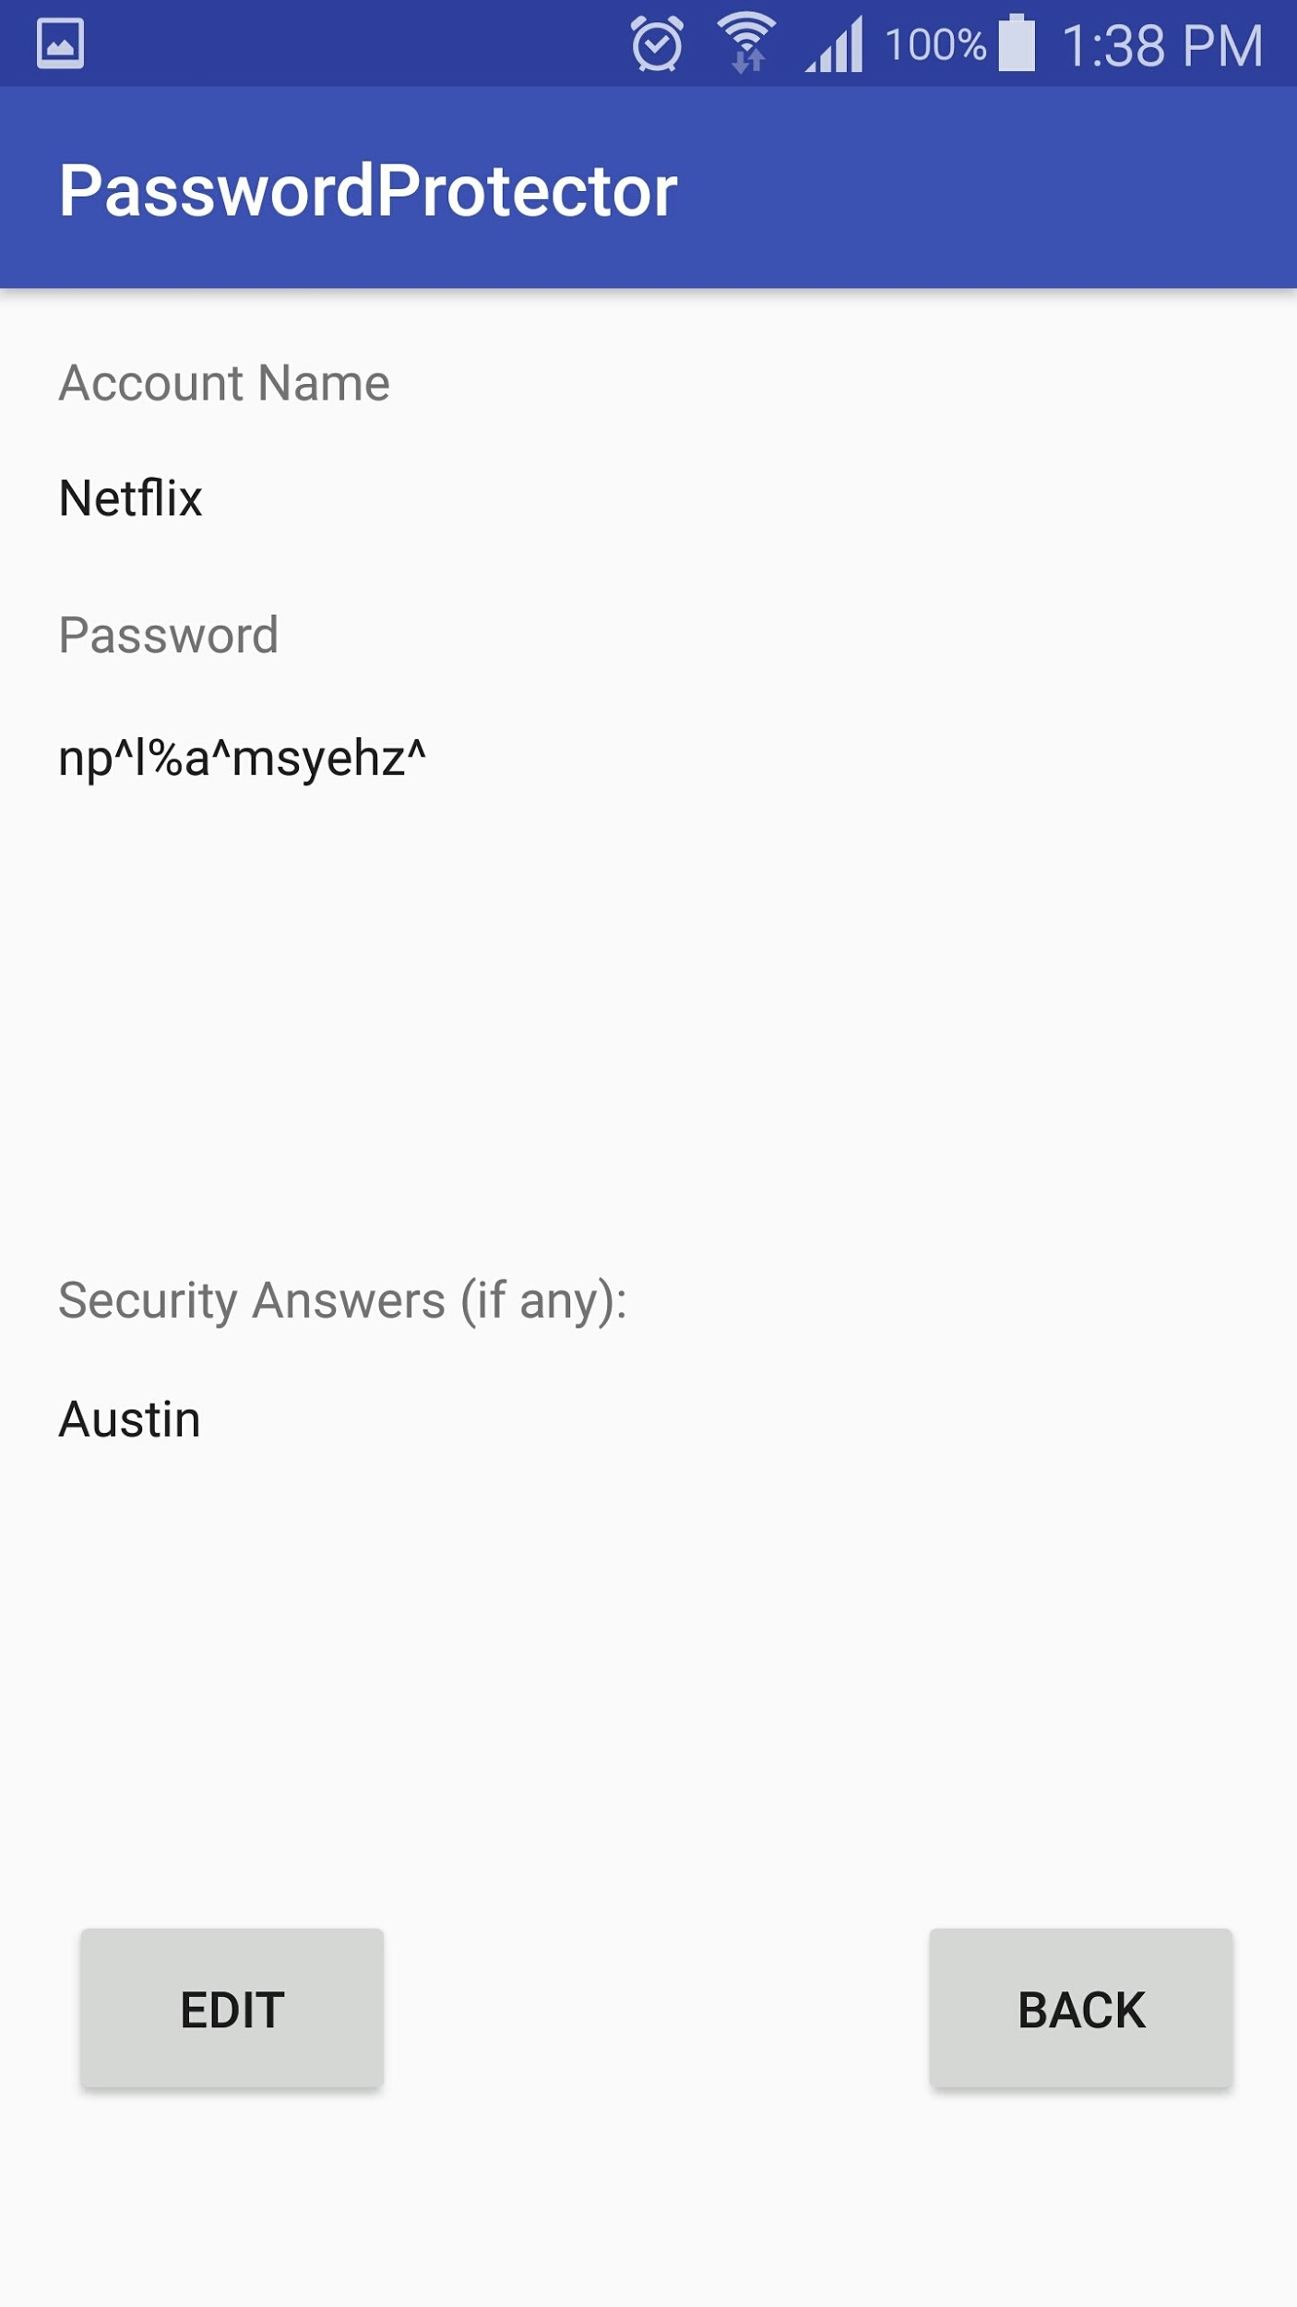
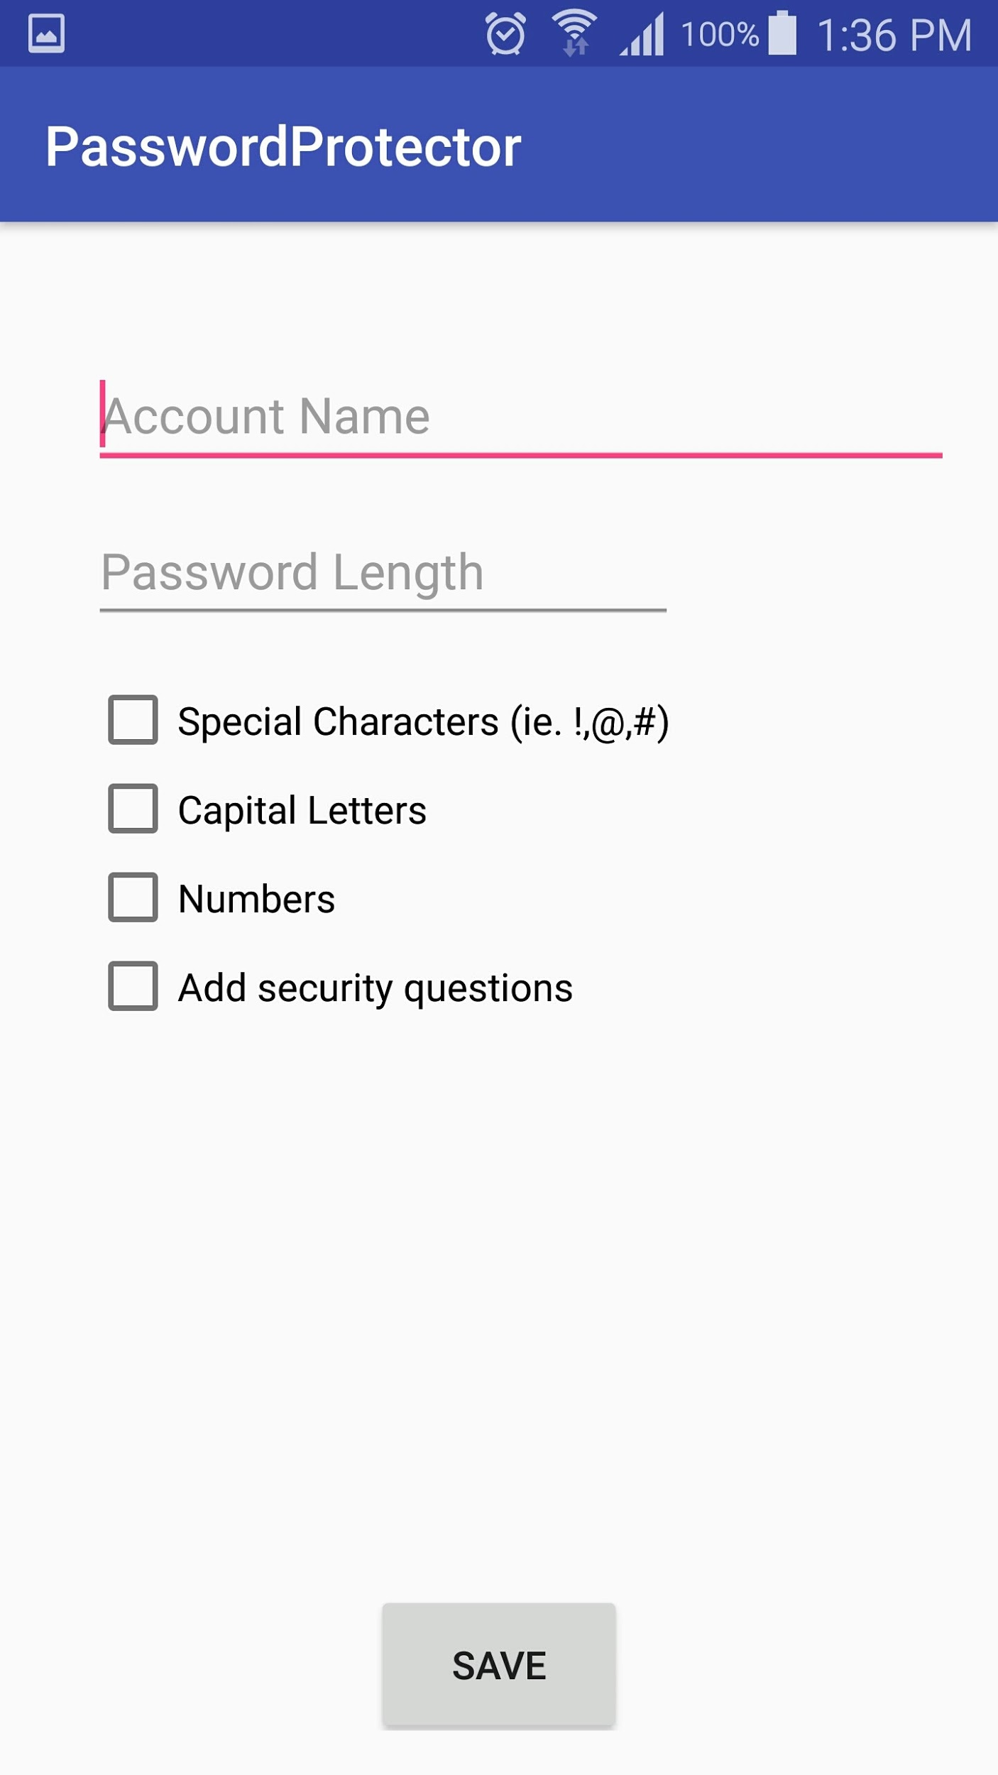
Demonstration

Slide 5

User Scenarios
If user uses one password for every account they own
If user switches between guest computers constantly
User has quick and easy access to many passwords

Slide 6


Experiences & Lessons
Android Studio, UI Development
SQL
JUnit testing
UI Testing
Project Management

Slide 7


Marketing
Free to use
Create Facebook page
Sharing on Facebook
Google App Store
App Store Optimization
Build a website
Send to tech bloggers

